Slide 1
Surge Technical Capabilities Camunda
1

Slide 2

DRIVING AGILITY IN TELECOMMUNICATIONS
Use Cases:
Order and Provisioning Management
Install, Un-install, Upgrade Device software
^{Vendor Management} Onboarding, Contract life cycle
^{Invoice Processing -} ^{Payment Management}
Cost Allocation & Dispute Management

Slide 3

Challenges
Challenges
Limitations with Zeebe-Kafka Connectors. Workflow Start Event can be mapped with single parameter
Retry – Mechanism was so rigid and static which makes the application to be redeployed for every changes in the retry mechanism parameters
Maintaining the application state in the Event Driven Architecture was the major challenge
Regulating the Alarm Management system was a big challenge as the RULES for generating the alarm keeps changing frequently

Slide 4
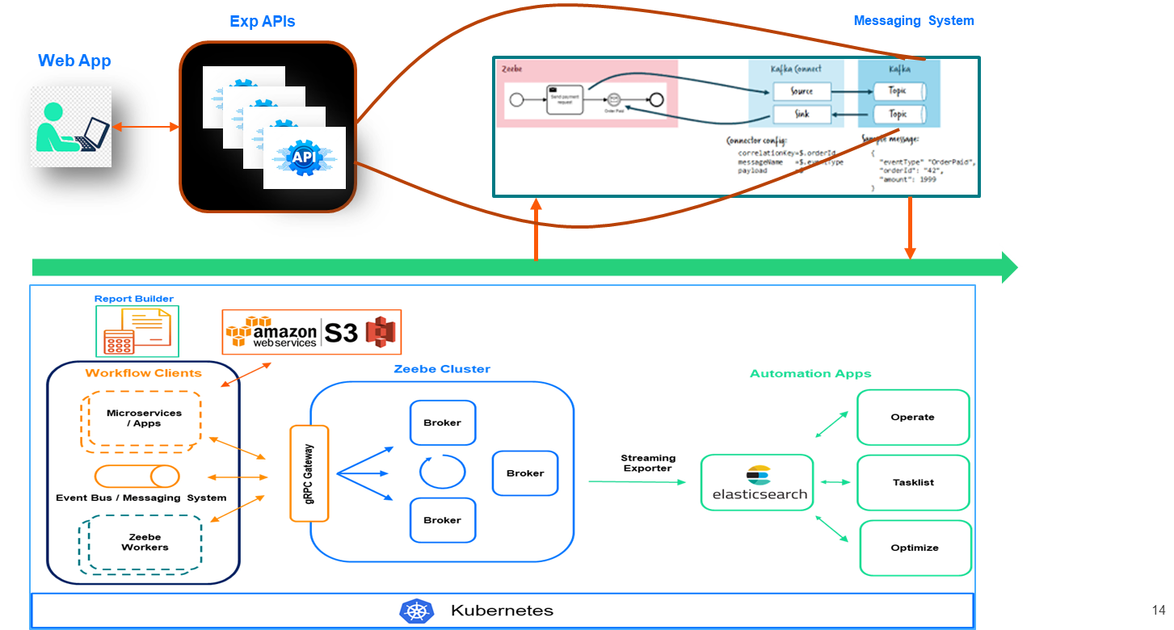
Solution Architecture
Solution
Team gained extensive knowledge on the Zeebe-Kafka connector and developed CUSTOMIZED Zeebe-Kafka connector to meet customer’s business use case
Custom retry mechanism was built and plugged in with NOTIFICATION MANAGEMENT SYSTEM using Camunda integration framework
Camunda Zeebe used as State Machine in Event Driven Microservice Architecture
Camunda – DMN used to build configurable Rule sets which reduced the overhead of multiple deployment cycle

Slide 5
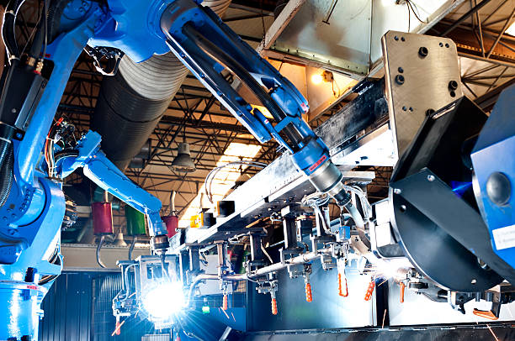
Leading Construction Equipment Manufacturer
Use Cases:
^{Consignment Delivery Tracking}
^{Defect Resolution Management}
Centralized Report Generation Platform
Machine maintenance & repair tracking

Slide 6

Challenges
Challenges
Gather Data from Multiple applications
Complex custom logic to process the data
Configurable RULE engine to bring more agility into in the workflow system
Business and IT teams struggle to communicate and collaborate to publish new Reports.

Slide 7
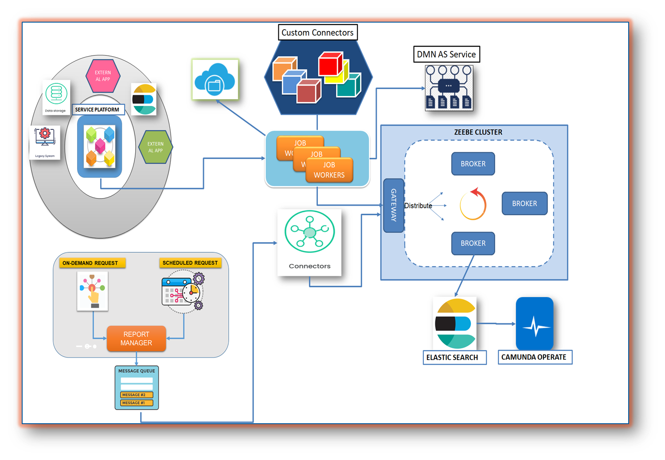
Solution Architecture
Solution
Existing solution was replaced by Camunda Process Orchestrator for collecting and aggregating data from multiple sources
Custom Connectors – 40% of logic has been moved as reusable components (Connectors) which can be used across the reports & developers has the flexibility to drag & drop the connectors while designing the process
Customized SQS Inbound Connector was build to support SQS Batch incoming messages with camunda engine

Slide 8
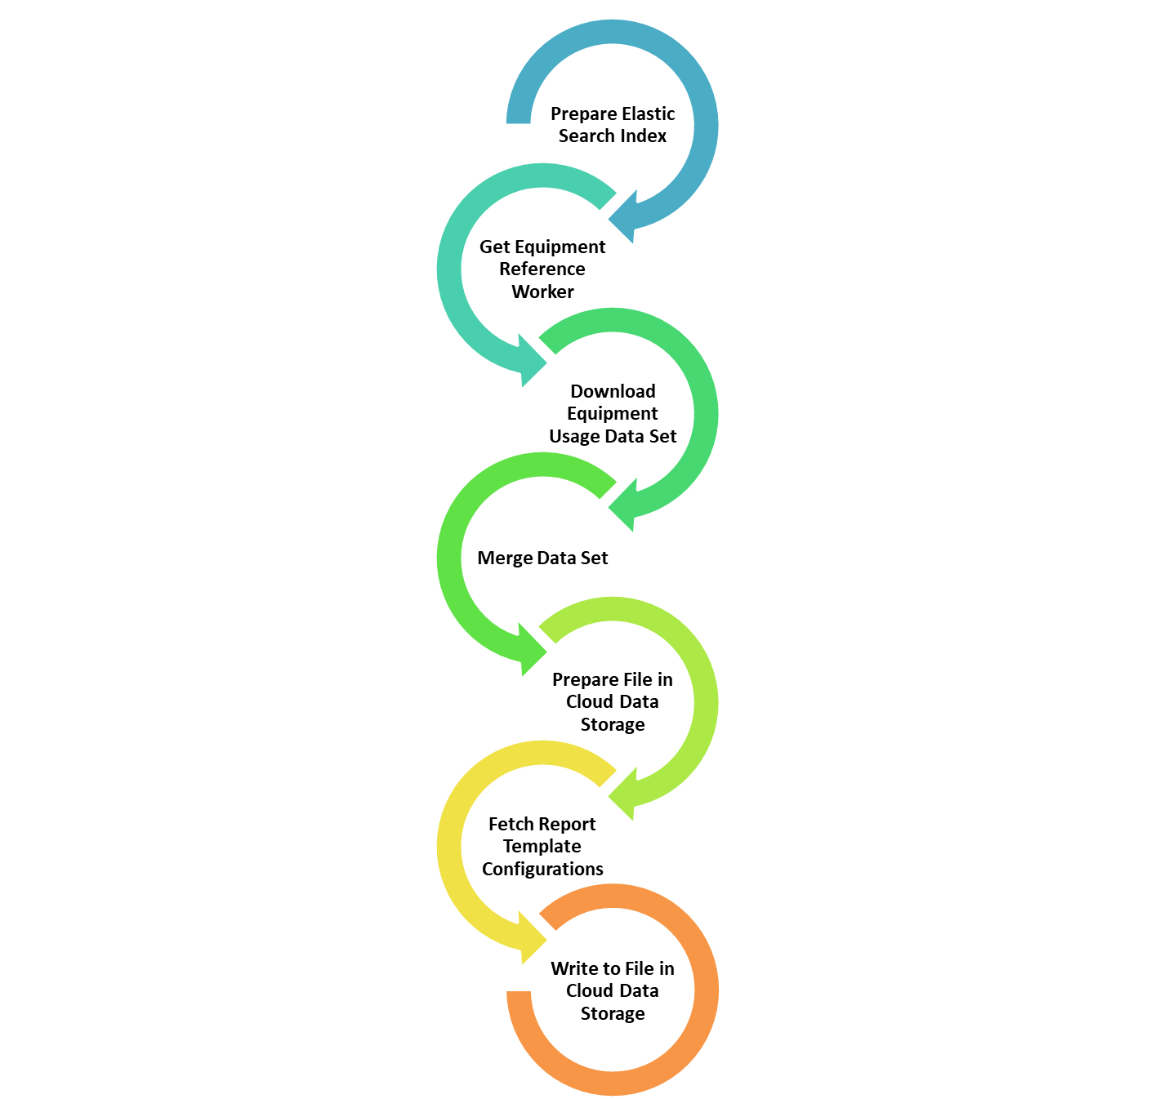
Equipment Management Report
Solutions
BUSINESS RULE AS SERVICE- Developed Custom Component BRAS
10% of the static business key attributes are moved into configurable business rules (DMN) & Business users has the flexibility to update the business rules
60% of Total effort has been reduced in development effort by using Custom Connectors and BRAS

Slide 9

Financial & Wealth Management
Use Cases:
^{Personal Banking} Services – Business deposit accounts, Cash Management Services
CreditPlus - A central asset management tool that combines your securities, checking and Visa Gold Card transactions into one single account
ClientLink – Online Access - Customer can access their accounts 24/7. It provides convenient online account access anytime you want it
^{Financial Advisor Onboarding}

Slide 10

Challenges
Challenges
Intuitive UI forms requested for orchestrating the user activities as Camunda forms meets basic functionalities
^{Data Aggregation} leads to carry out huge volume of data across the process tasks
Camunda 8 has limitation over no OUT OF BOX AUTHENTICATION and KEYCLOAK made mandatory

Slide 11
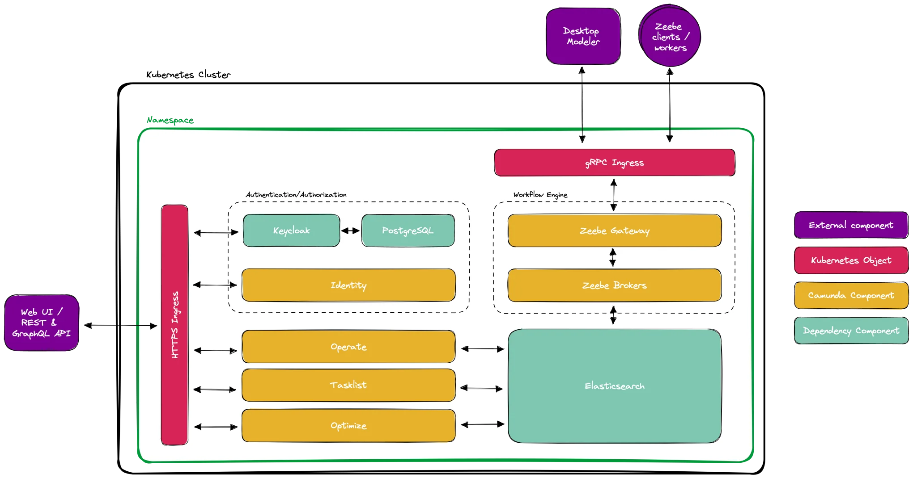
Solution Architecture
Solutions
Built customized Task list application to address Human Task Orchestration with Rich UI using ReactJs and Tasklist APIs
Our solution over comes the process instance max size limit 4 mb by enabling the intercepting temporary storage (Elastic)
Customer had a different identity provider in use, we forced to set up Keycloak as an identity provider so that you are forced to run Keycloak in addition to your existing identity provider for Camunda 8

Slide 12


